Slide 1

Arabic
Text-to-Speech(TTS)
Done By:
Ahmed Gamal Ahmed Moataz Saied Saleh
Myar Hany Mohamed Mona Badr Moustafa

Slide 2

WHAT IS Text-to-Speech?
Text-to-Speech (TTS) that converts written text into spoken words., TTS systems generate natural-sounding speech from textual input, enabling computers and devices to "talk.“
Text Input: Users provide text in various formats (e.g., documents, scripts, or typed input).
Voice Output: The system produces synthesized speech, replicating human-like intonation and pronunciation.

Slide 3
TABLE OF CONTENTS
01.
02.
03.
INTRODUCTION
Phase 1
Phase 2
04.
Models
05.
Project Summary

Slide 4

01.
INTRODUCTION

Slide 5
Phase 1 Pipeline
Audio Extraction from YouTube Videos
Audio Trimming and Duration Handling
Vocal Isolation
De-Noising
01.
02.
03.
04.
06.
05.
Whisper transcriptions
Boosting Volume

Slide 6
Phase 2 Pipeline
Removing Duplicates
Mapping and Renaming File Names
Filtering and Cleaning Transcriptions
Generating Transcription Files for Model Input
01.
02.
03.
04.
05.
06.
07.
08.
Extracting Mel Spectrograms
Preprocessing the Text File
Preprocessing Audio Files for Tacotron 2
Add Titles to WAV files
10.
09.
Converting Buckwalter to Phonemes
Text Preprocessing

Slide 7
02.
Phase 1

Slide 8
01. Audio Extraction from YouTube Videos
Input Keywords
list of arabic keywords to search for relevant YouTube videos.
Search and Filter
Uses the "pytube" library to search for videos.
Filters videos based on duration (e.g., 5–15 minutes)
Audio Download
Uses "yt-dlp" to download and extract audio in WAV format.
Saves audio files to organized folders by keyword.
Error Handling
Handles issues like invalid URLs or download failures gracefully.

Slide 9
02. Audio Trimming and Duration Handling
Purpose
Automate the process of extracting fixed-length audio segments (default: 10 seconds).
Ensure audio files meet the required duration before processing.

Slide 10
03. Vocal Isolation
What is Vocal Isolation?
Separating vocals from instrumental tracks in mixed audio files.

Slide 11
04. Audio Trimming and Duration Handling
What is Vocal Isolation?
Key Benefits of Spleeter
Separating vocals from instrumental tracks in mixed audio files.
Speed: Processes audio quickly and accurately.Simplicity: Easy to use with pre-trained models.
How Does Spleeter Work?
Uses AI-powered models to split audio into two components:
Vocals: The speaker's voice.
Accompaniment: Background noise

Slide 12
05. Volume Boosting for Audio Files
Purpose
Increase the loudness of an audio file by amplifying its sound levels without distortion.
Process
Load the audio file to extract its data and sampling rate.
Amplify the audio signal by multiplying it with a specified factor.
Convert the amplified data to the correct format.
Save the boosted audio as a new file.

Slide 13
06. Audio Transcription with Whisper
Purpose
Convert spoken audio into text and store the transcription in a CSV file for easy access and analysis.
Process
Load the Whisper model for transcribing audio files.
Transcribe the input audio to extract the spoken text.
Record metadata (file name, directory) and transcription results.
Append the transcription to a CSV file for organized storage.

Slide 14
02.
Phase 2

Slide 15
01.Removing Duplicates
Description
The script identifies and removes duplicate rows from the original CSV file to ensure there are no redundant entries.

Slide 16
02. Mapping and Renaming File Names
01
02
03
Converts long, unreadable video file names to sequential numbers (e.g., 1, 2, 3, etc.).
Updates the .wav files in the folder to match these new names.
Adds the new file names to the transcription CSV file and saves it as Before Final Transcriptions.csv.

Slide 17
03. Filtering and Cleaning Transcriptions
01
02
03
Checks each transcription in the updated CSV file for anomalies (e.g., fully English text or unusual characters).
Deletes the corresponding .wav file from the audio folder.
Removes rows with such transcriptions from the CSV file.

Slide 18
04. Generating Transcription Files for Model Input
Description
The transcriptions_converter.py script extracts the .wav file names and their corresponding transcriptions from the CSV file.
Why is this done?
This format was required by a previous model used during development.
For the new model, the input format is different. The text file will later be converted to match the requirements of the final model, as explained in a subsequent notebook.

Slide 19
05. Preprocessing the Text File
Fixing delimiters
Removing extra spaces
Ensures there is only one “|” separator between the .wav file name and its transcription.
Cleans up unnecessary spaces within the transcriptions.
Validation
Verifies that all .wav files mentioned in the text file actually exist in the wavs folder.

Slide 20
06. Preprocessing Audio Files for Fastpitch
Description
The preprocess_for_tacotron.py script prepares the .wav files for use with the Fastpitch model.
Process
Sample Rate Conversion: Reads all .wav files at a sample rate of 22050 Hz, which is required by Fastpitch .
Silence Trimming: Removes any silent segments from the audio files.
Normalization: Normalizes the audio files to ensure consistent volume levels.
Saving: Saves the processed .wav files for use in training.

Slide 21
07. Adding Titles to WAV Files
Description
The add_titles_to_wavs.py script ensures that each .wav file has a corresponding title.
The title is set to match the exact name of the .wav file (e.g., 1.wav will have the title 1).
Why is this necessary?
The Fastpitch model requires a Title column in the dataset to process the audio files correctly.
This script populates the previously empty Title column in the dataset with the appropriate values.

Slide 22
08. Extracting MelSpectrograms
What are Mel Spectrograms?
A visual representation of audio frequencies over time, mapped to the Mel scale, which reflects how humans perceive sound.
Used as input features for speech models like Tacotron 2 because they capture key speech characteristics like pitch and tone.
What Does extract_f0.py Do?
Processes .wav files at 22050 Hz.
Converts audio into Mel spectrograms using a Short-Time Fourier Transform (STFT).
Optionally extracts pitch features (F0).
Saves the results in a format usable by the model.

Slide 23
09. Text Preprocessing
Transliteration to Buckwalter Format
Vowelization
Loading the Vowelizer: The Shakkelha tool is used to add Arabic diacritics (tashkeel) to the text, converting plain Arabic into diacritized text.
Cleans up unnecessary spaces within the transcriptions.
Formatting for the Model
The text file is reformatted to match the input requirements of the model.
For example:Original format: wavs/1.wav|اهلا
Reformatted: "1.wav" "ahlan“

Slide 24
10. Converting Buckwalter to Phonemes
Description
After transliterating Arabic text to Buckwalter (e.g., "ahlan"), the text is further converted into phonemes, which represent the sounds of the words.
For example:
Buckwalter: ahlan
Phonemes: ʔ-a-h-l-a
Phonemes use specialized characters to capture the precise pronunciation, making them suitable as input for the model.

Slide 25
04. Models
01.
02.
Tacotron 2
FastPitch

Slide 26
Models
Tacotron 2
FastPitch (12 Epochs)
Loss Function: Mean Squared Error (MSE)
Epochs: 12
Metrics:
Training Loss: 2.9478
Gradient Norm: 2.0667
Validation Loss: 2.5164
Performance:
Worst in terms of naturalness and speech clarity.
Loss Function: Advanced Loss
Epochs: 12
Metrics:
Training Loss: 11.0213
Gradient Norm: 17.0301
Performance:
Second-best. Decent performance overall.
FastPitch (40 Epochs)
Loss Function: Advanced Loss
Epochs: 40
Metrics:
Training Loss: 8.0658
Gradient Norm: 12.8098
Performance:
Best model in terms of naturalness and speech clarity.

Slide 27
05.Project Summary

Slide 28
Preprocessing
Text and Audio Data Preparation
Cleaned and renamed .wav files and transcriptions for consistency.
Preprocessed audio files (resampling, trimming silence, and normalization)
text (vowelization, Buckwalter transliteration, and phoneme conversion).
Extracted Mel spectrograms for audio features using extract_f0.py.
Structured text and audio data into formats compatible with the models.
Verified all data integrity before training.
Model Training and Fine-Tuning
Tacotron 2 (12 epochs): Least natural and clear.
FastPitch (12 epochs): Moderate performance.
FastPitch (40 epochs): Best in terms of naturalness and speech clarity.

Slide 29
Bonus

Slide 30
01. Evaluation Metrics
Mel Cepstral Distortion (MCD)
F0 Error (Fundamental Frequency Error)
Tacotron 2 Model: 43.2082
FastPitch Model (12 Epochs): 34.1908
FastPitch Model (40 Epochs): 28.3875
Tacotron 2 Model:
RMSE: 117.2998
MAE: 110.9427
FastPitch Model (12 Epochs):
RMSE: 105.6899
MAE: 99.7382
FastPitch Model (40 Epochs):
RMSE: 90.6519
MAE: 84.7837
Conclusion
FastPitch (40 Epochs) outperformed the other models with the lowest MCD and F0 Error values, indicating the best similarity to the original audio and accurate pitch reproduction.

Slide 31
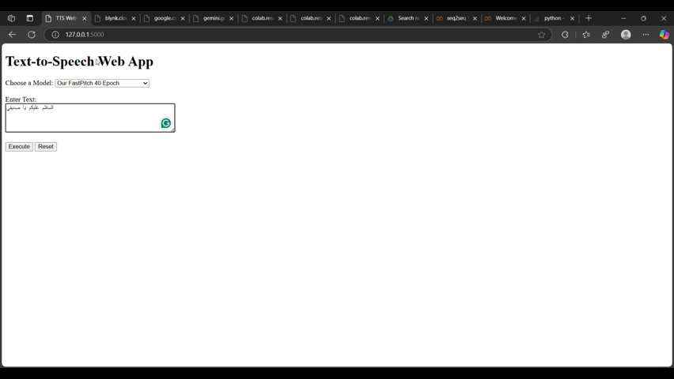
02.Flask App

Slide 32
THANKS!

